Slide 1
Stored Procedure with CASE Statement
Lab 10

Slide 2
Simple CASE expression
This compares an expression to a set of simple expressions to find the result. This expression compares an expression to the expression in each WHEN clause for equivalency. If the expression with in the WHEN clause is matched, the expression in the THEN clause will be returned.
Syntax
CASE expression
WHEN expression1 THEN Result1
WHEN expression2 THEN Result2
ELSE ResultN
END

Slide 3
Example - 1
USE Northwind
SELECT TOP 10 OrderID, [EmployeeID], Position =
CASE [EmployeeID]
WHEN 1 THEN 'First'
WHEN 2 THEN 'Second'
WHEN 3 THEN 'Third'
WHEN 4 THEN 'Fourth'
ELSE 'Something Else'
END
FROM Orders

Slide 4
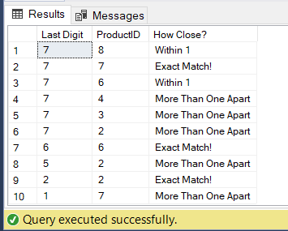
Example - 2
USE Northwind
SELECT TOP 10 OrderID % 10 AS "Last Digit",
ProductID,
"How Close?" = CASE OrderID % 10
WHEN ProductID THEN 'Exact Match!'
WHEN ProductID - 1 THEN 'Within 1'
WHEN ProductID + 1 THEN 'Within 1'
ELSE 'More Than One Apart'
END
FROM [Order Details]
WHERE ProductID < 10
ORDER BY OrderID DESC;

Slide 5
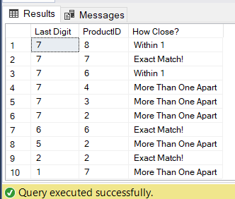
Example
CREATE PROCEDURE conditionals
AS
BEGIN
SELECT TOP 10 OrderID % 10 AS "Last Digit",
ProductID,
"How Close?" = CASE OrderID % 10
WHEN ProductID THEN 'Exact Match!'
WHEN ProductID - 1 THEN 'Within 1'
WHEN ProductID + 1 THEN 'Within 1'
ELSE 'More Than One Apart'
END
FROM [Order Details]
WHERE ProductID < 10
ORDER BY OrderID DESC
END;
EXEC conditionals;

Slide 6
Searched CASE expressions
This expression evaluates a set of Boolean expressions to find the result. This expression allows comparison operators, and logical operators AND/OR with in each Boolean expression.
Syntax
CASE
WHEN Boolean_expression1 THEN Result1
WHEN Boolean_expression2 THEN Result2
ELSE ResultN
END

Slide 7
Example - 3
--Last Query
USE Northwind
SELECT TOP 10 OrderId, OrderID % 10 AS "Last Digit",
ProductID,
"How Close?" = CASE
WHEN (OrderID % 10) < 3 THEN 'Ends With Less Than Three'
WHEN ProductID = 6 THEN 'ProductID is 6'
WHEN ABS(OrderID % 10 - ProductID) <= 1 THEN 'Within 1'
ELSE 'More Than One Apart'
END
FROM [Order Details]
WHERE ProductID < 10
ORDER BY OrderID DESC

Slide 8
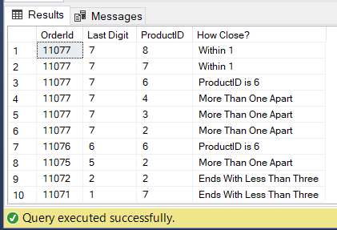
Example - 3

Slide 9
Task
Stored Procedures with Case Statement
TASK # 01: Display Author_Name, Author_ID, Title_Id and Type from Author and TitleAuthor tables using pubs database.
4th Column named Type is based on following case statement:
when TitleId starts with BU then its Type is Business
when TitleId starts with TC then its Type is Traditional Cooking
when TitleId starts with PC then its Type is Popular Computing
when TitleId starts with MC then its Type is Modern Cooking
when TitleId starts with PS then its Type is Psychology

